Slide 1
Introduction to
Digital Image Processing

Slide 2
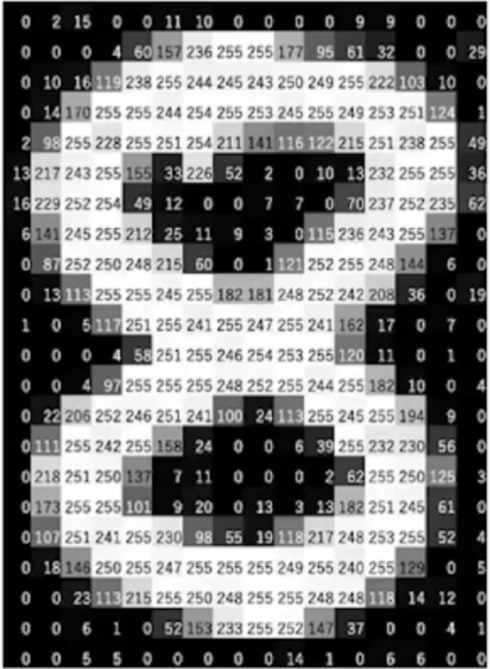
Image
An image is a two-dimensional array of pixels, each of which represents a different color or grayscale value.
In digital form, images are represented as matrices of pixel values, where each pixel value corresponds to a particular color or shade of gray.

Slide 3
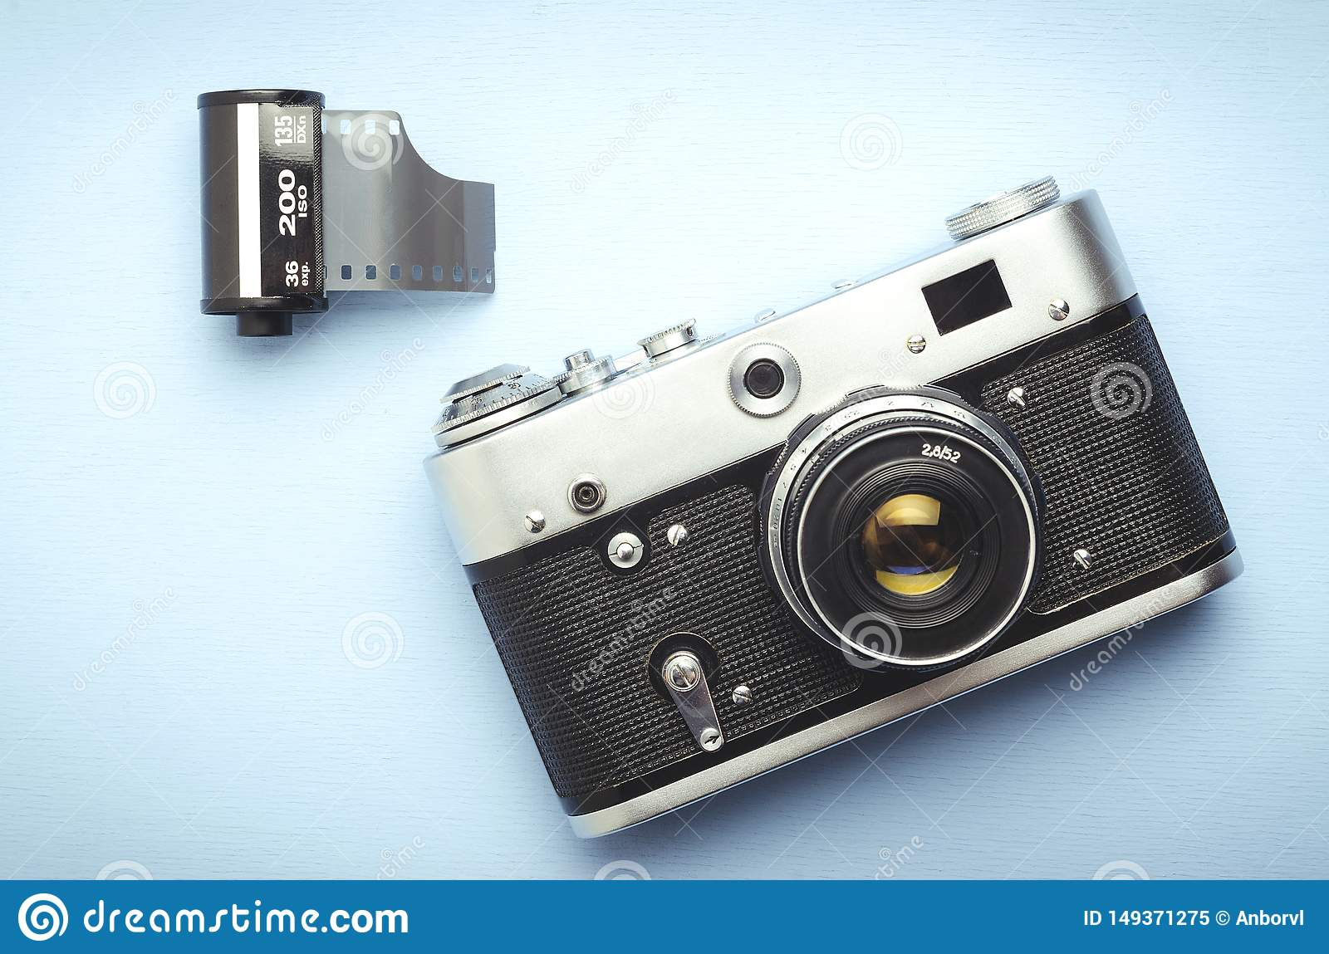
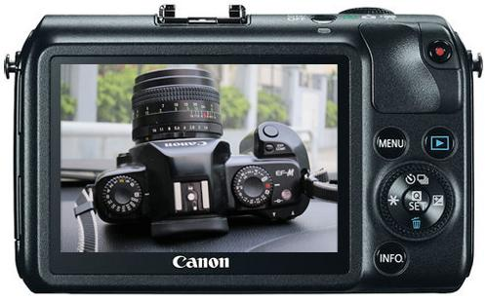
Analog vs. Digital Images
Analog images are continuous signals that represent real-world objects. | Digital images are discrete signals that are represented by numerical values.
Analog images can take on any value within a continuous range | Digital images are made up of a finite number of pixels, each of which corresponds to a specific color or grayscale value.
Analog film, painting etc | Images we see everyday on TV or phone

Slide 4
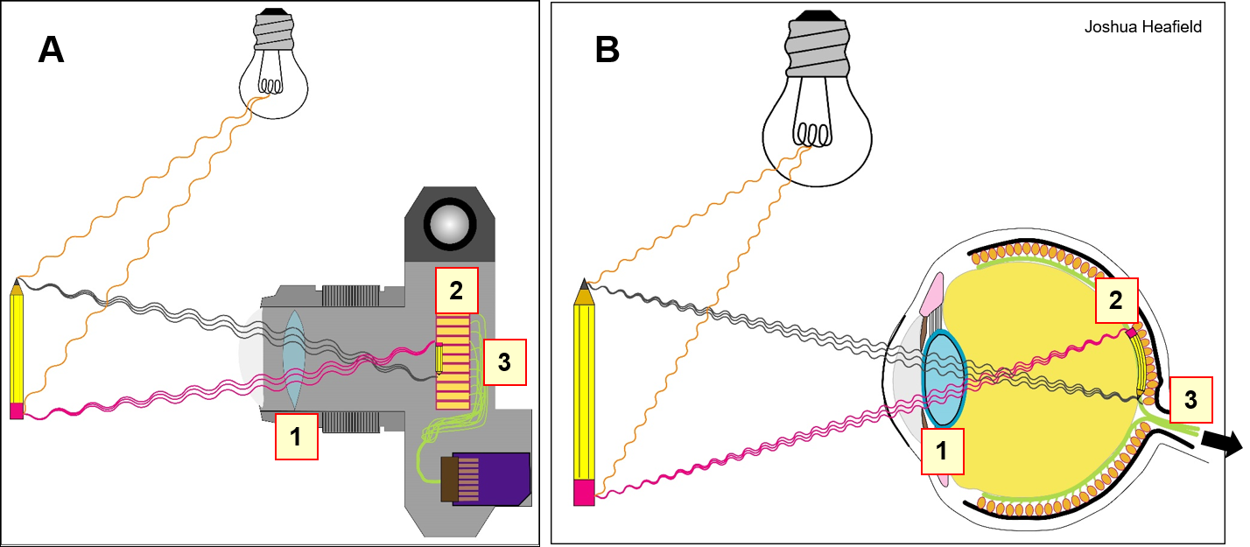
Human Vision and Image Processing
Image processing techniques are designed to mimic or improve upon the way that the human visual system processes and interprets images. Understanding how the human visual system works can inform the development of image processing techniques that are optimized for human perception and cognition.

Slide 5
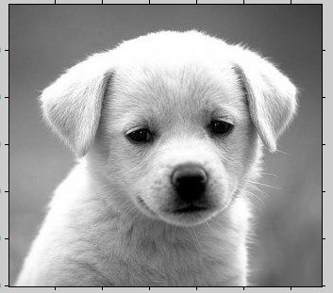

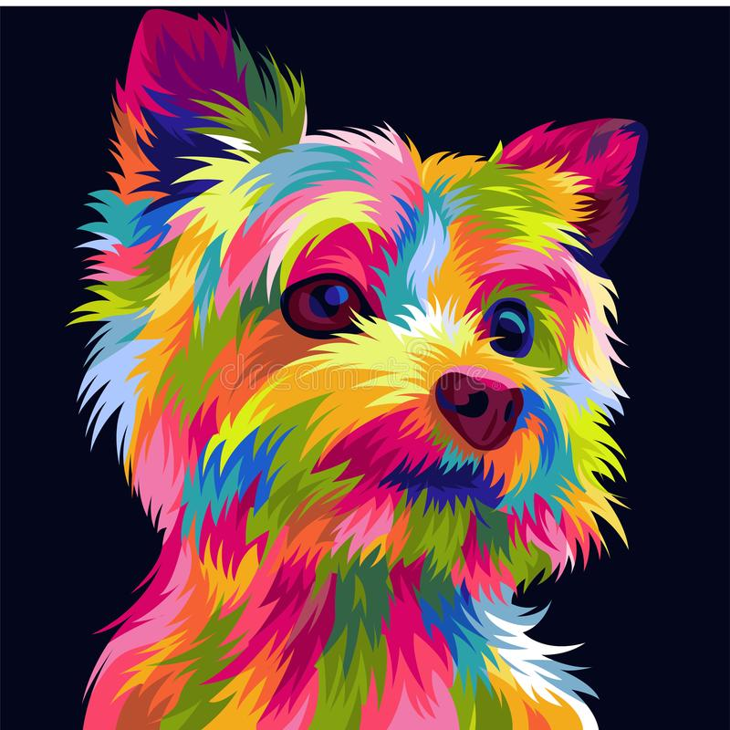
Types of Digital Images
Grayscale Images Grayscale images represent each pixel with a single value (e.g. [0, 255]) that corresponds to the brightness of the pixel.
Binary Images
Binary images have only two possible values (black or white)
Color Images Color images are made up of multiple channels of pixel values, each representing a different color

Slide 6
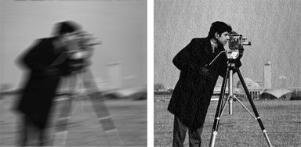
Image Enhancement
Image enhancement refers to the process of improving the visual quality of an image by modifying its brightness, contrast, color balance, or other image characteristics.
It is an important step in image processing because it can improve the usability and usefulness of images for a wide range of applications.

Slide 7
Types of Image Enhancement Techniques
Point Processing
Histogram Processing
Spatial Filtering
Frequency Filtering
Edge Enhancement.

Slide 8
Arithmetic & Logic Operations for point processing
Arithmetic & logic operations on images are used
extensively in most image processing applications
May cover the entire image or a subset
Arithmetic operation between pixels p and q are
defined as:
Addition: (p+q)
Used often for image averaging to reduce noise
Subtraction: (p-q)
Used often for static background removal
Multiplication: (p*q) (or pq, p×q)
Used to correct gray-level shading
Division: (p÷q) (or p/q)
As in multiplication

Slide 9
Logic Operations
Logical operation between pixels p and q are defined
as:
AND: p AND q (also p⋅q)
OR: p OR q (also p+q)
COMPLEMENT: NOTq (also q‟)
Applicable to binary images
Basic tools in binary image processing, used for:
Masking
Feature detection
Shape analysis

Slide 10
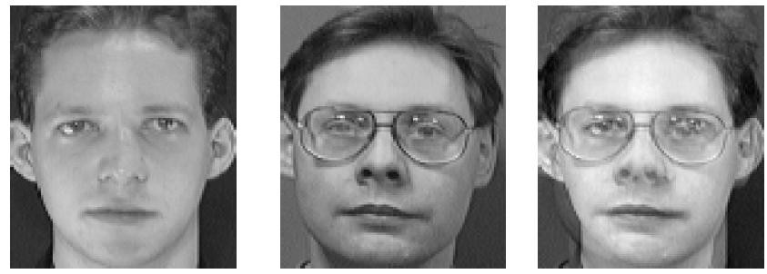
Examples of Arithmetic Operations-Addition
Useful for combining information between two
images
0 <= a <= 1

Slide 11
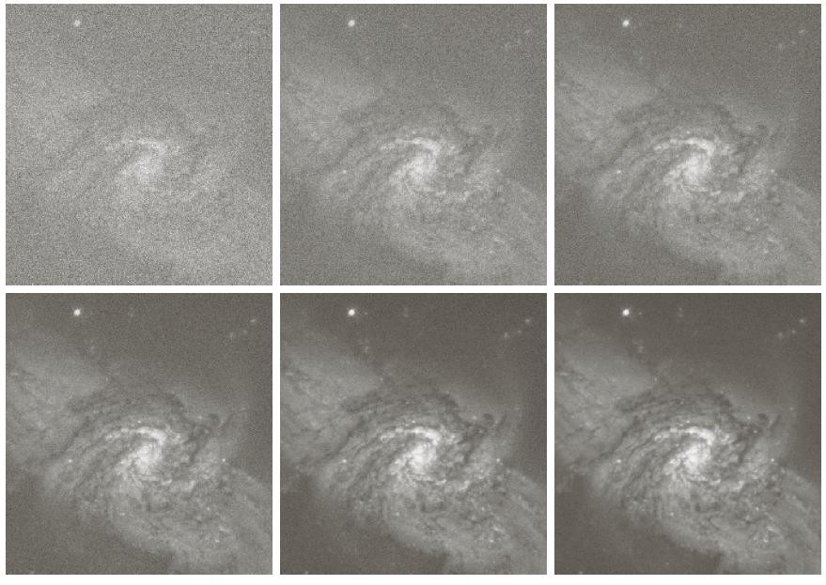
Averaging
Image quality can be improved by averaging a
number of images together (very useful in astronomy applications).
5
10
images must be registered!
20
50
100

Slide 12
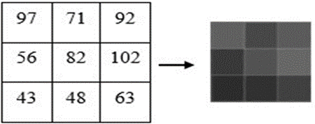
What will happen if I just adds on?

Slide 13
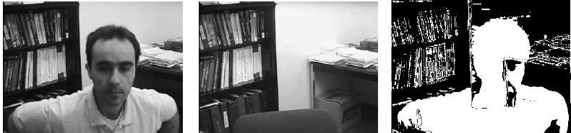
Subtraction
Useful for “change” detection.

Slide 14
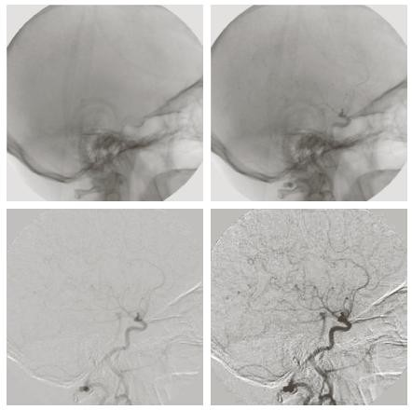
Subtraction (cont‟d)
iodine medium injected into the bloodstream
Medical application.
difference
enhanced

Slide 15

Multiplication/Division
Used to adjust the brightness of the image.
multiplication by 2

Slide 16
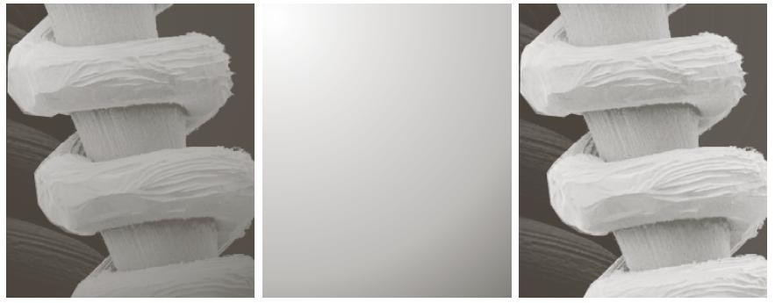
Multiplication/Division (cont‟d)
Suppose a sensor introduces some shading in the
form:
g(x,y)=f(x,y) h(x,y)
We can estimate h(x,y) and remove shading by
division.
original
shade pattern shade correction

Slide 17
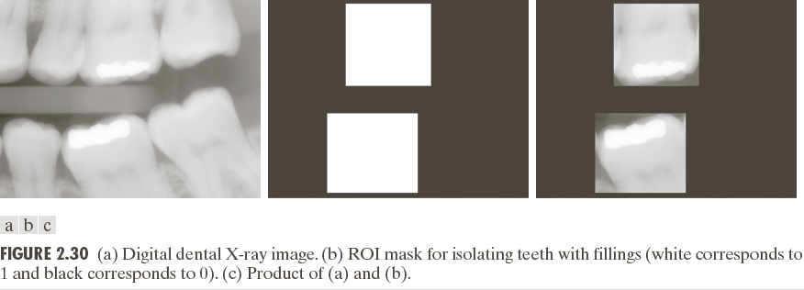
Example: Multiplication- Masking
g(x,y)=f(x,y) h(x,y)

Slide 18
Comments
Arithmetic operation can produce pixel values outside
of the range [0 – 255].
You should convert values back to the range [0 – 255]
to ensure that the image is displayed properly.
How would you do the following mapping?
[f_{min} – f_{max}] [ 0 – 255]
More on point processing from this book(Section 2.6): https://dl.icdst.org/pdfs/files4/01c56e081202b62bd7d3b4f8545775fb.pdf

Slide 19
Histogram Equalization
Histogram equalization is a technique that adjusts the contrast of an image by redistributing the pixel values in its histogram.
Advantages: The advantages of histogram equalization include its simplicity and effectiveness in improving the contrast of images.
Disadvantages: The disadvantages include the possibility of introducing artificial noise into the image, and the tendency for the technique to amplify noise in the image.

Slide 20

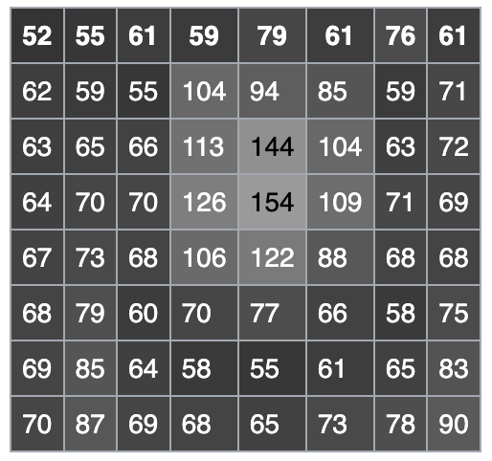
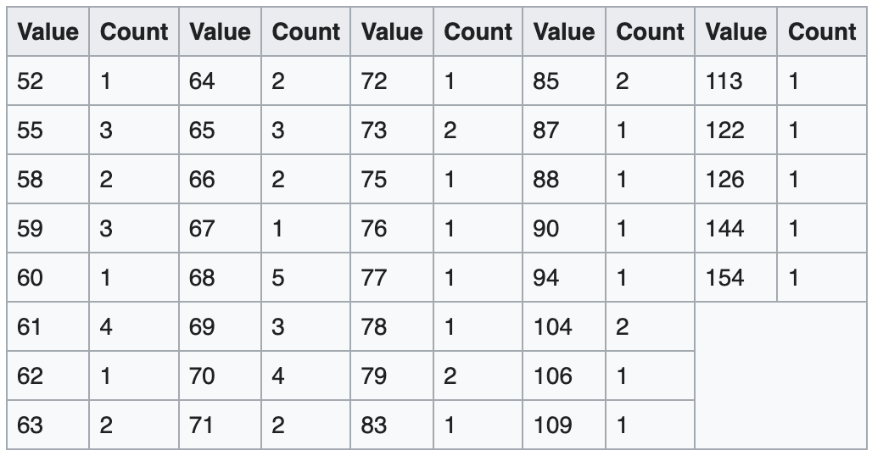
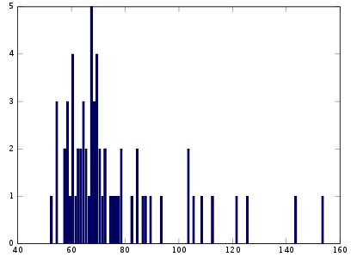
How Histogram Equalization Works

Slide 21
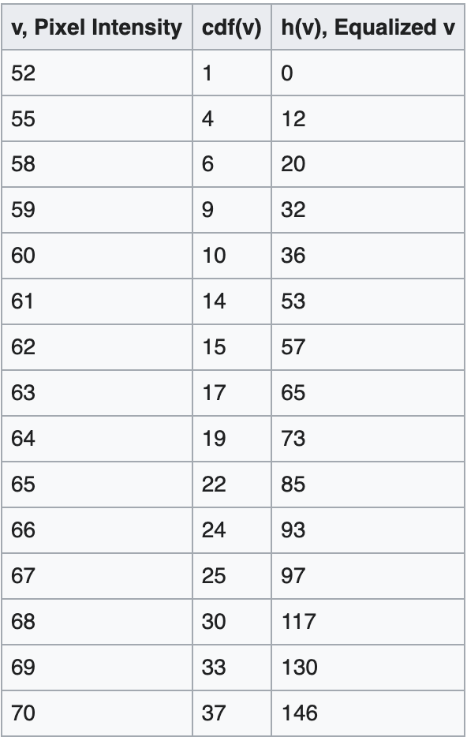
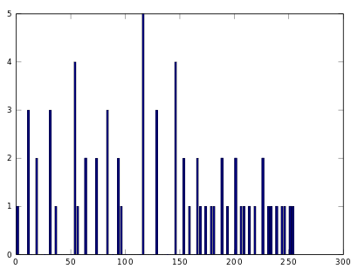
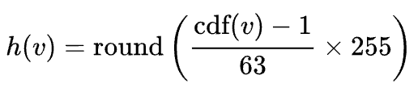
How Histogram Equalization Works
cdf(v) = cumulative distribution function

Slide 22
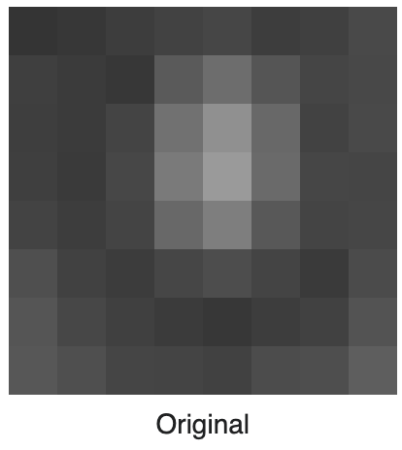
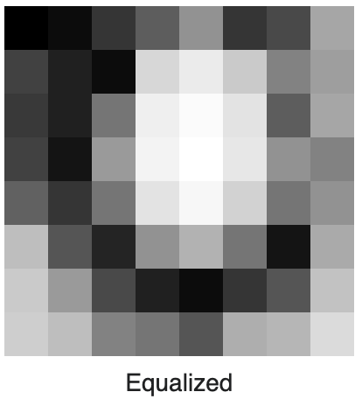
How Histogram Equalization Works
Finally …

Slide 23
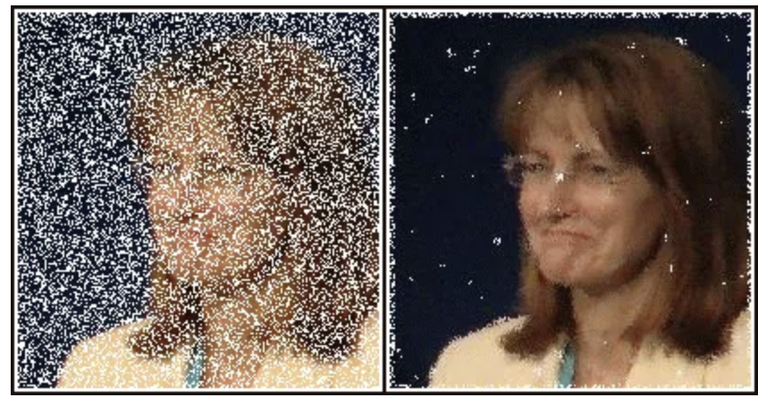
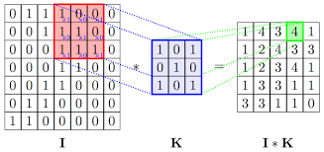
Filters for Image processing
Filtering is a standard operation performed on digital images. In image processing, we use 2D filtering techniques. Filters are normally used to remove noises from the image while keeping the image preserved. It’s a technique used for modifying or enhancing the quality of the image.

Slide 24
Types of Filters in Image Enhancement
Mean Filter
Gaussian filter
Low Pass Filter
High Pass Filter
Band Pass Filter

Slide 25
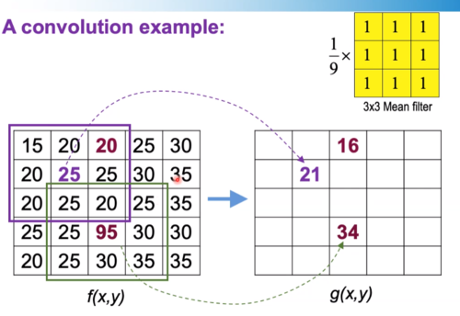
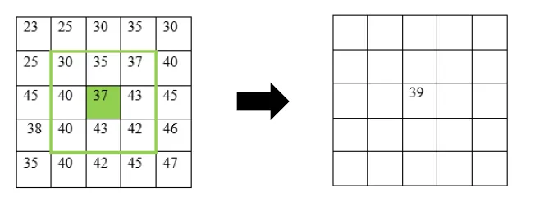
Types of Filters in Image Enhancement (Example)
Mean Filter: The mean filter works by moving through the image pixel by pixel, replacing each value with the average grey level values of neighboring pixels, including itself. There exist two types of mean filters.
Average filter
Weighted-average filter

Slide 26
Types of Filters in Image Enhancement (Example)
Low Pass Filter: A low pass filter can be represented as G(x,y)=H(x,y).F(x,y) where F(x,y) is the Fourier Transform of original image and H(x,y) is the Fourier Transform of filtering mask.
High Pass Filter: It is used for sharpening the image. A high pass filter is given by the equation G*(x,y)=1-G(x,y) where G(x,y) is low pass filtering output.

Slide 27
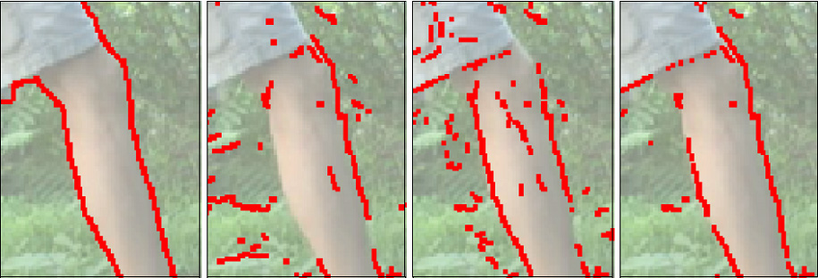
Edge Detection
Edge detection is an image processing technique for finding the boundaries of objects within images, which can improve the visibility and clarity of the image. Edge detection is used for image segmentation and data extraction in areas such as image processing, computer vision, and machine vision. Can be used for applying common image effects such as portrait mode, blurry background, etc.

Slide 28
Common techniques for edge detection
Sobel Edge Detection
Prewitt Edge Detection
Canny Edge Detection

Slide 29
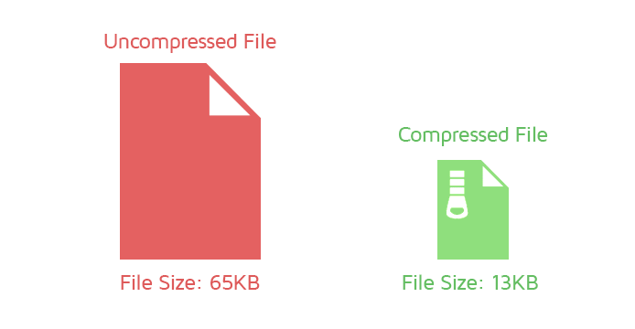
Image Compression
Image compression is the process of reducing the size of an image file while preserving its visual quality.

Slide 30
Why Image Compression is Useful?
Reduces Storage Requirements
Speeds Up Transmission
Improves the Performance of Image Processing Algorithms

Slide 31
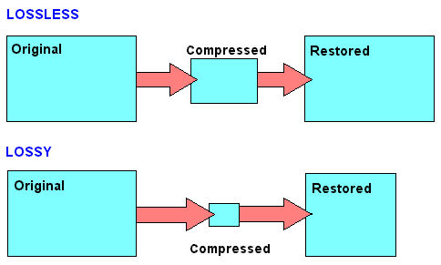
Types of Image Compression Technique
Lossless Compression | Lossy Compression
Lossless compression is a compression technique that reduces the size of an image file without losing any information. | Lossy compression is a compression technique that reduces the size of an image file by removing some of the information that is considered less important or less noticeable to the human eye.
It works by finding and removing redundancies in the image data | It works by quantizing the image data and discarding the least significant bits.

Slide 32
Application of Image Processing
Video Editing
Photo Editing
Video Games
Medical Imaging
Surveillance
Remote Sensing
Digital Security

Slide 33
Thanks!

